Slide 1

Bird e-scooters set to
fly in Charlottesville
An analysis of how Bird should enter
UVA’s transportation market
Tyler West, Keyu Chen, Tosan Johnson, Phoenix Jitpaisarnsook, Vivian Kim, Meg Garland
Notes:
Good morning everyone,
This past month the city of charlottesville approved a pilot program for the operation of electric scooters in the city. — allowing interested companies to file proposals for servicing the area.
Today, as the business analytics team, we’re here to provide Bird, a burgeoning e-scooter company, with strategies on entering Charlottesville’s market and structuring a successful pilot program. My name is Vivian Kim and these are my teammates --

Slide 2

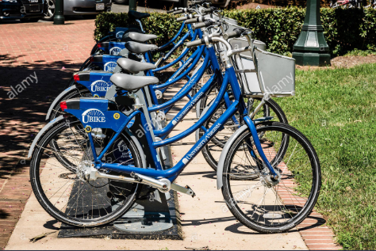
UBike did not fly in Charlottesville
CavDaily: UBike Suspended
Notes:
In 2011, Cavalier Daily first cites the beginnings of Ubike proposals, with much approval from the university community - both faculty and students.
The summer of 2014, marked the kick off of this program on Grounds, receiving funding from VDOT
however, today, four years later, we see that these racks remain largely untouched, with few students holding memberships for ubikes
This evidence raises the questions: What places Bird in a better spot than UBike? How can Bird learn from UBike’s failure?

Slide 3

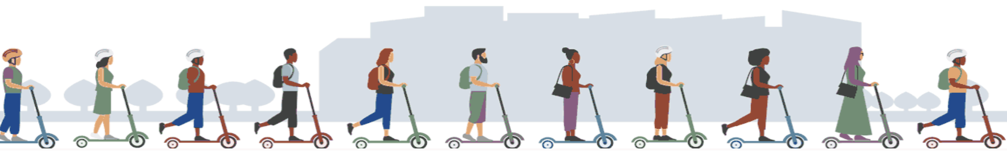
Agenda
Executive Summary
Bird’s Value Proposition
UVA’s Current Transportation Market
Key Factors to Successful Integration
Recommendations
Risks and Mitigation Plan
Q&A
Notes:
Today we’ll answer these questions through an analysis on Bird’s Value Proposition, UVA’s current transportation market, key factors to successful integration… (and our recommendations and risks)

Slide 4
Executive Summary
Recommendation
Develop a strong pilot program, targeting early consumer adoption, to create a strong foundation for Bird at UVA
1
2
3
Bird’s Value Proposition
Capitalize on Bird’s current positioning in the e-scooter space
Transportation Market
Emphasize user experience in comparison to competitors at UVA
Integration
Operate in conjunction with university and consumer preferences
Notes:
Our final recommendation was to focus on promotions, user experience, geo-fencing in order to encourage early consumer adoption and build a strong foundation for Bird’s services at UVA

Slide 5
Bird’s Value Proposition

Slide 6

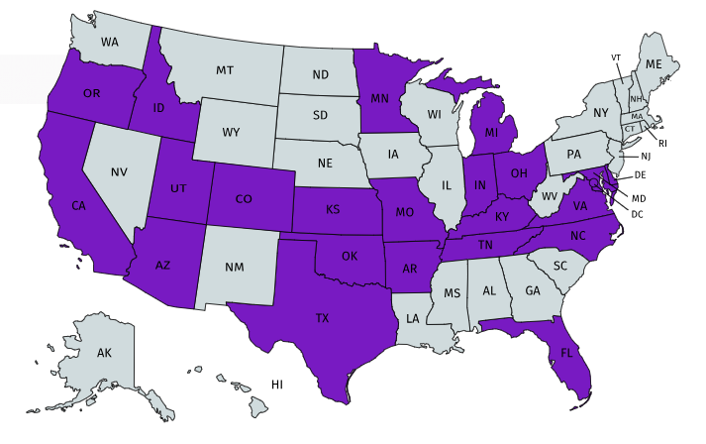
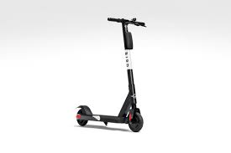
is a rapidly growing e-scooter company
Total financing at $418 million
73 cities across the United States
17 universities across the United States
Total number of users at over 2 million
“Be free from traffic and pollution”
Notes:
https://www.bird.co/
https://www.reuters.com/article/us-bird-funding/scooter-startup-bird-raises-300-million-in-latest-funding-round-idUSKBN1JO2N8
https://techcrunch.com/2018/09/20/bird-hits-10-million-scooter-rides/
Founded in April of 2017, Bird has expanded rapidly to 73 cities across the United States and over 100 cities worldwide. Of its locations, Bird places a heavy emphasis on college campus given their desirable demographics. Students are tech-savvy, many have tight wallets, and have places they need to get to quickly. Thus far, Bird has been able to attract over 2 million users and $418 million in financing, providing Bird with a great basis for extending its services to the UVA student body as well.

Slide 7
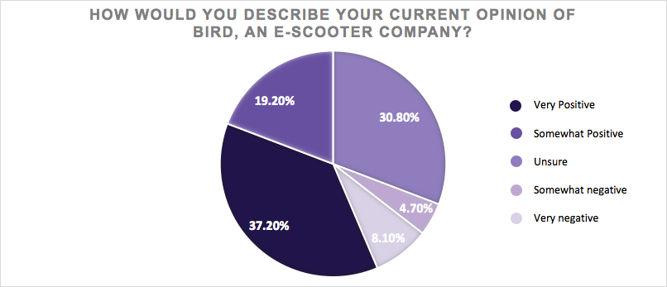
56% of UVA students view Bird positively
Somewhat Positive
Unsure
Very Positive
Notes:
As part of our research, we created a 7 question survey and distributed it amongst over 150 UVA students. The questions in our survey revolved around 2 topics: 1) students opinions of transportation options at UVA and 2) student opinions of Bird. This particular graphic shows the results of our survey question gauging current student perceptions of Bird. As you can see…
As you can see from this graphic, over 56 percent of UVA students have a positive opinion on Bird, exemplified by their scoring of Bird as very positive or somewhat positive. Additionally, just over 30 percent of UVA students say they are unsure about Bird, meaning that educating customers about Bird’s offering will be essential as Bird continues to expand
Introduce survey FIRST

Slide 8
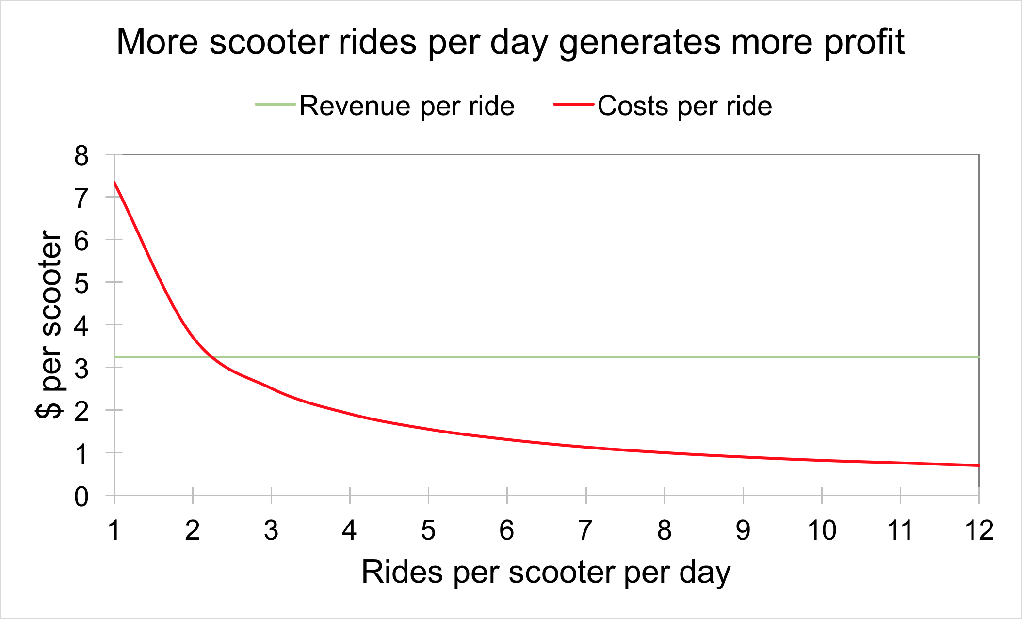
Scooter rides per day are key to Bird’s success
At 3 rides per scooter per day, Bird starts to become profitable.
However, Bird should aim to become profitable within the first month of launching at UVA.
Source: Bird financial assumptions
Notes:
Meg
In addition to capitalizing on Bird’s brand, we also wanted to capitalize on Bird’s business model. To do that, we drew conclusions from the unit economics of one scooter, which is depicted in the graph. Based on a number of assumptions and information gathered from data online, we depicted how one Bird scooter’s revenue per ride and cost per ride change based on the number of rides per day that single scooter experiences. An average of 3 rides per day would make the per ride profit for one scooter just above zero. However, we advise that Bird implement a launch strategy that maintains 7 rides per scooter per day. By maintaining this average per scooter usage, Bird scooters would experience a higher per ride profitability, and Bird would be able to breakeven on the initial cost of one scooter in under a month. By becoming profitable within the first month, Bird will be able to fund continuous marketing and communication with the UVA community.

Slide 9
UVA’s Current Transportation Market

Slide 10




Bird should position itself carefully
Positive user experience
Carpooling
Walking
Personal Bike
High accessibility
Low accessibility
Personal Car
Negative user experience
Notes:
Then we move to the market section,
As you can see the horizontal axis shows
Accessible = how easy it is to find or order this mode of transport
The vertical axis shows
User experience = how enjoyable the experience of actually using that mode of transportation is
This 2 by 2 metrics is based on our survey of 173 UVa students
Our most popular public transportation are UVA Buses
65% of student often use UVA bus system to get around UVA.
And 17% of people often use Uber or Left.
While only 0.6% of student used Ubike.
Aside from public transportation, student also like to walking due to it’s 0 costs and easy to access,
And drive their personal car or bike and carpooling as a supplement from the public transportations.
In a such a competitive market, Bird should position itself carefully by provide a highly positive user experience and accessible

Slide 11
UVA transportation market is lacking
Potential Opportunities
Transportation method | Affordability | Accessibility | User experience
E-scooter
UBike
Bus
Uber/Lyft
Personal Car
Walking
Notes:
Then we moved to UVA transportation market,
We can see the graph shows the Affordability, accessibility and User experience of most popular transportation in the UVA community
Do a graphic on this slide with the green dots as potential opportunities on affordability and convenience’
User experience = how enjoyable the experience of actually using that mode of transportation is
Accessible = how easy it is to find or order this mode of transport

Slide 12
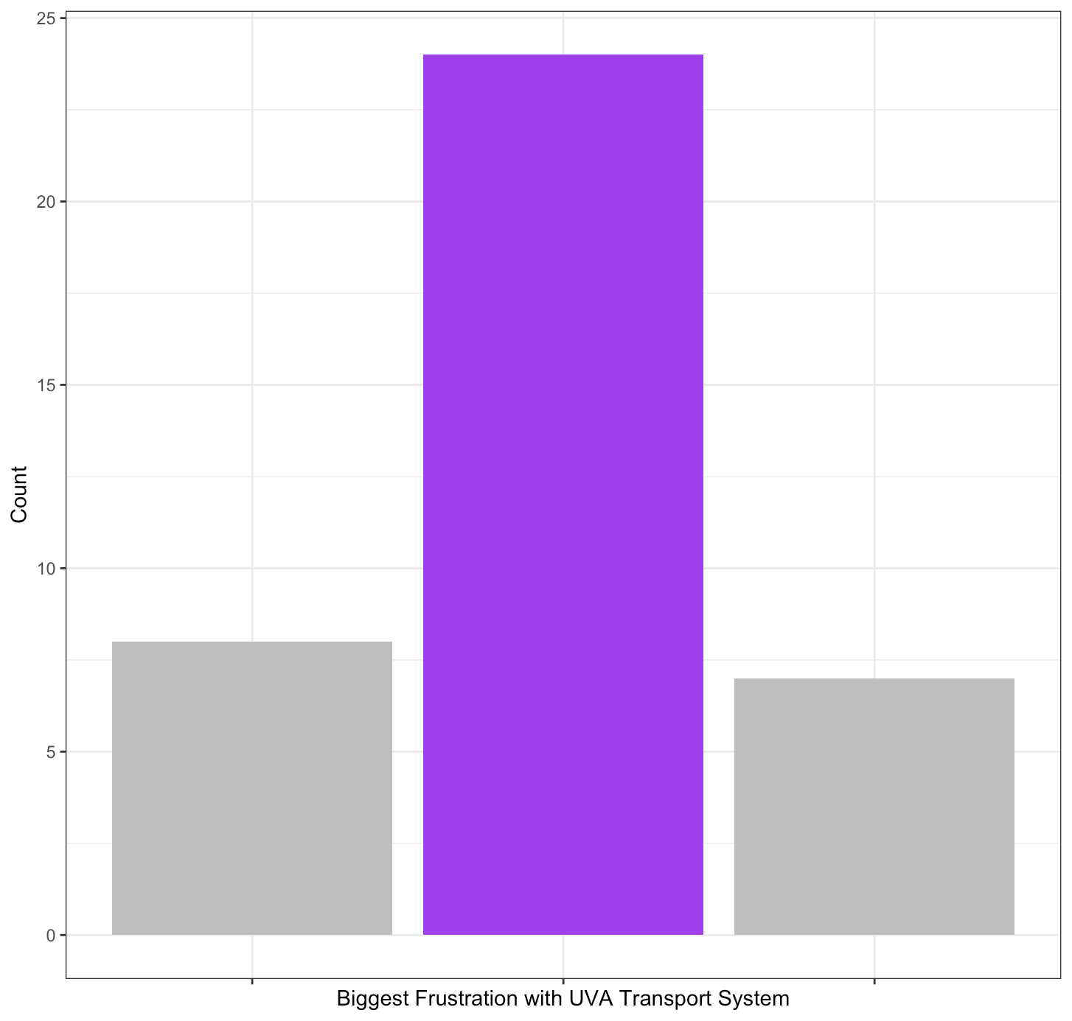
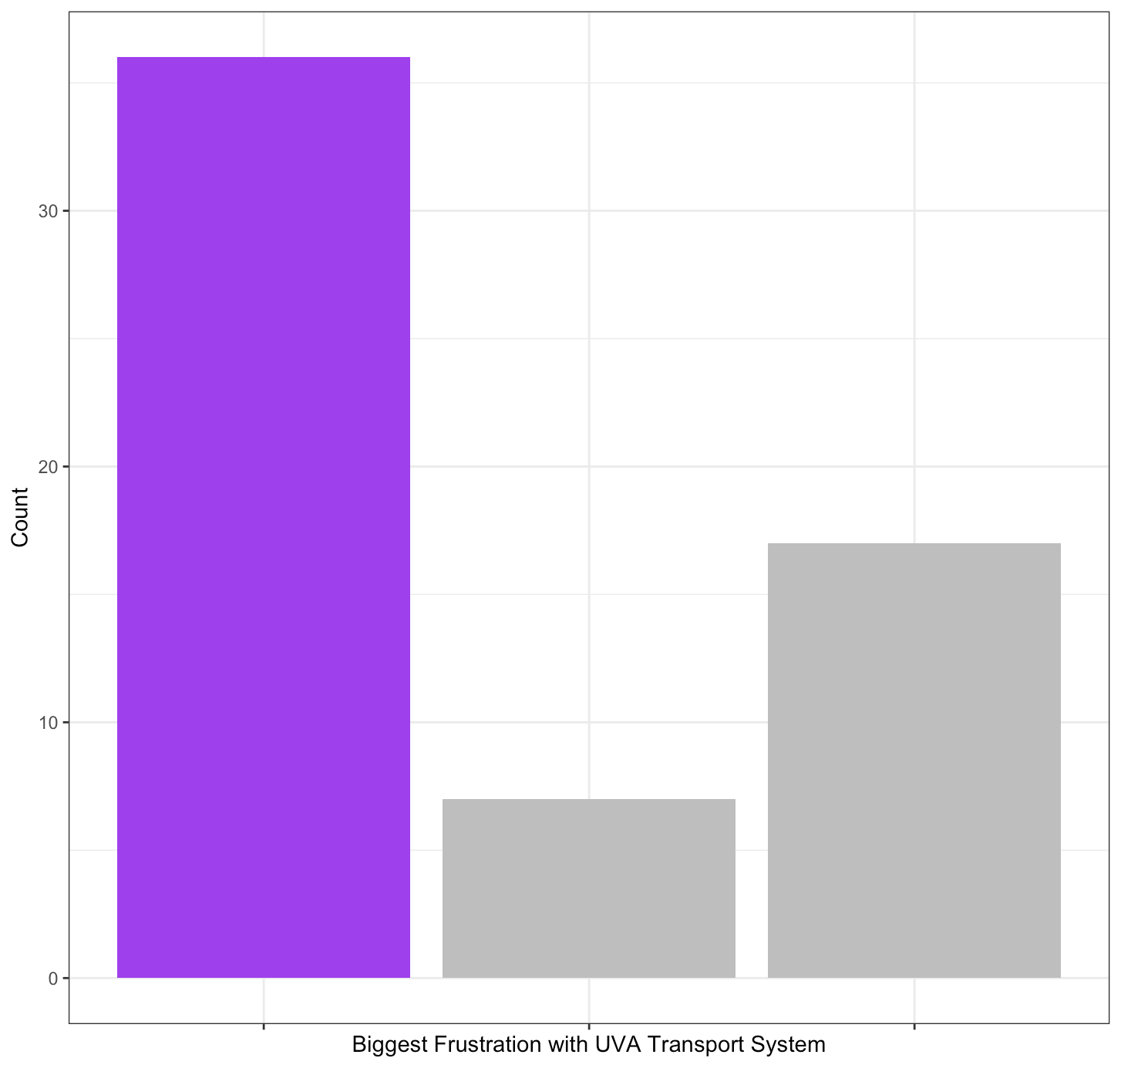
Capturing two ends of the market
Biggest frustration for non-riders
Biggest frustration for frequent riders
20
10
0
30
20
10
0
VS.
Time Location Reliability
Time Location Reliability
Students’ biggest frustration with UVA’s transport system varies based on ride frequency.
Notes:
The biggest frustration with current transportation For students who take uva transportation zero times per week,
was that transportation options aren’t available at locations that are convenient to where they live.
For students who take uva transport over five times per week,
their biggest frustration was that uva transportation options are not available at the times that they need them.
For students who take uva transportation zero times per week,
their biggest frustration with current options at UVA was that transportation options aren’t available at locations that are convenient to where they live.
For students who take uva transport over five times per week,
their biggest frustration was that uva transportation options are not available at the times that they need them.
UVA transport options are.
Current transportation options are the UTS bus system and UBike.
Students who take uva transport more than five times per week had a different frustration.
One of the questions in our survey asked students what their biggest frustrations with UVA transportation such like UTS bus system and UBike.

Slide 13


User experience and functionality are crucial
Use UVA transport 0 times per week,
26% of respondents.
Use UVA transport 5+ times per week,
40% of respondents.
VS.
Majority have very positive opinion of Bird
More likely to use personal cars
Majority are unsure of their opinion of Bird
More likely to use UVA’s bus system
Notes:
Students who used uva transport zero times per week were more likely to have a positive opinion of Bird
Students who used it over 5 times per week were unsure of their opinion of Bird
Based on these results, it is crucial that we cater solutions to these preferences.
We need to advertise that Bird scooters are in convenient locations AND we need to incorporate positive brand messaging in our launch of Bird at UVA.
Other survey questions we had asked for students current opinion of Bird and asked what transportation options students use most often.
The results of these questions varied based on how many times students use uva transportation options.
and were more likely to use personal cars to get around UVA.
and were more likely to use the UVA bus system to get around UVA.

Slide 14
Key Factors to Successful Integration

Slide 15
“We won’t just launch on a university without prior approval… At UVA, we have to be cautious, obviously, with riding on the Lawn. We meet with the university on Monday. -- Their main concern is because the lawn is historic and there’s not much foot path there.”
Cameron Kilberg
Senior Manager of Government Affairs at Bird

Slide 16
“We won’t just launch on a university without prior approval… At UVA, we have to be cautious, obviously, with riding on the Lawn. We meet with the university on Monday. -- Their main concern is because the lawn is historic and there’s not much foot path there.”
Cameron Kilberg
Senior Manager of Government Affairs at Bird

Slide 17

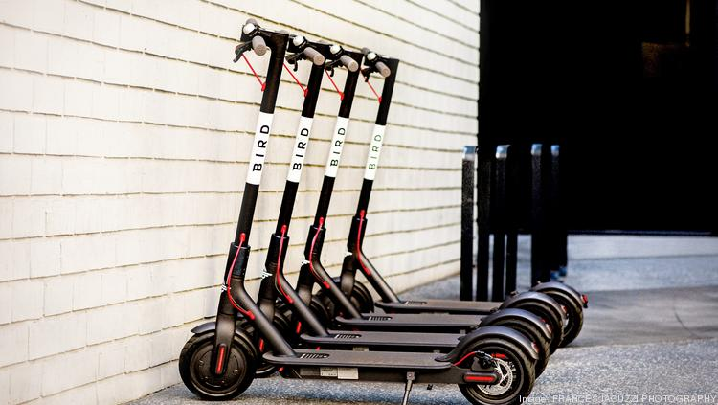
University regulation is a significant hurdle
Other Campuses
University of Virginia
While Bird currently services 17 campuses, it has also been banned from a few. Issues listed include:
Lack of prior communication (UNC - Chapel Hill)
Students riding Bird scooters while intoxicated (UC - San Diego)
Abandoned Birds due to lack of battery charge (Loyola Marymount)
“The addition of e-scooters to an area with a high level of pedestrian traffic raises a number of safety concerns.”
Obey all traffic laws
Do not operate, park, or re-charge these vehicles on sidewalks or in University buildings
Be aware the University Housing prohibits these vehicles from being brought inside residence halls
Park in designated hubs for U-bike parking.
Gloria Graham
UVA Associate Vice President for Safety and Security
Source: Slate.com, Call with Bird Representative, UVA Dean Allen Groves
Notes:
Cautious obvi, riding on the lawn - We meet with the university on monday - we’ll work with the university on monday, just because the lawn is historic and there’s not much footpath”
Since Bird’s inception many university campuses have banned Bird Scooters. Campuses that have banned electric scooters: Arizona State, University of Arizona, University of Missouri, Ohio State University, Michigan State University, Loyola Marymount University
UNC- https://www.newsobserver.com/news/local/article217385695.html
UCSD - https://slate.com/technology/2018/11/college-campuses-electric-scooters-bird-lime-razor.html
LMU - http://www.laloyolan.com/news/lmu-temporarily-bans-electric-scooters-like-bird-and-lime-on/article_b0dd7f8f-989a-5dc5-aca9-5aae165de546.html
-------------------------
Obey all traffic laws including street signs, traffic lights, and speed limits. Use caution when approaching and passing pedestrians. / Do not operate, park, or re-charge these vehicles on sidewalks or in University buildings. This prohibition includes the University’s Medical Center buildings. / Be aware that University Housing prohibits these vehicles from being brought inside residence halls. / Park in designated hubs for U-bike parking. Parking in other locations, like sidewalks, building entrances, streets, grass, ramps, etc. impedes accessibility for members of our community and emergency responders.
POINT HERE - need to abide by regulations AND help uva in enforcing regulations to mitigate chaos
-compare: cities, universities uva
-Grove’s comments and Dean Petters (about within dorms)
- One case that went well, one that didn’t go well
- Other schools: https://www.insidehighered.com/news/2018/10/10/e-scooters-are-causing-safety-and-accessibility-headaches-campuses

Slide 18
“We won’t just launch on a university without prior approval… At UVA, we have to be cautious, obviously, with riding on the Lawn. We meet with the university on Monday. -- Their main concern is because the lawn is historic and there’s not much foot path there.”
Cameron Kilberg
Senior Manager of Government Affairs at Bird

Slide 19
Takeaways from UBike
“Bikers who are following bike lanes are thrust into traffic and a state of panic when the bike lane abruptly ends.”
Cavalier Daily
Which transportation options do UVA students prefer? | Number of Responses
Personal Car | 70
Carpooling with others | 29
Zipcar | 1
Uber or Lyft | 30
Walking | 157
UVA Bus system | 113
Personal Bike | 15
UBike | 1
Number of Bikes
Placement of Bikes
Balance
Notes:
POINT BEING: successes and failures of ubike on grounds and why that led us to looking into STUDENT PERCEPTION, REGULATION, AND INFRASTRUCTURE for bird
http://www.cavalierdaily.com/article/2018/04/students-and-faculty-face-barriers-to-biking
https://www.cvilletomorrow.org/articles/uva-bike-program-reports-growing-number-of-trips

Slide 20
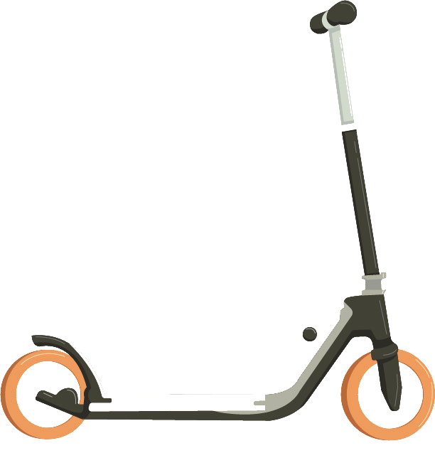
Current infrastructure needs improvement
3
Lack of bike lanes, hilly terrain, brick sidewalks, and high traffic periods
between classes impinge upon
Bird’s success.
Use geofencing to allow parking and riding only in designated areas.
2
Create more bike lanes for safe riding.
1
Clearly communicate expectations.
Source: UVA Parking & Transportation
Notes:
Clearly communicate expectations within the student community
Create bike lanes Downtown and on Alderman Road for safe riding. This will decrease use of Bird Scooters on sidewalks and make riding safer on larger streets
Innovate technology to allow parking or riding only in designated areas. By implementing geofencing, (using current GPS systems,) Bird can alert riders to refrain from riding in areas of high pedestrian traffic (ie. around the amphitheatre) or in areas deemed unsafe
-------------------------------
POINT HERE: big challenges here, need to integrate and make more bike lanes/precautions for safety
Bike lanes, terrain (hills and cobblestone), compare with cities that worked for biking/scooters, traffic flow (students crossing streets, cars, students walking), street access
Charging (not solar powered, cant charge in school facilites -dorms, etc)
"It will be a pilot program that creates a corridor for cars and bicycles in places where the road is not wide enough for a separate bicycle lane," White said. "They will run down Alderman Road from McCormick Road to Jefferson Park Avenue. The road has to be relatively flat and the car has to be moving at about the same speed as the bicycles."

Slide 21
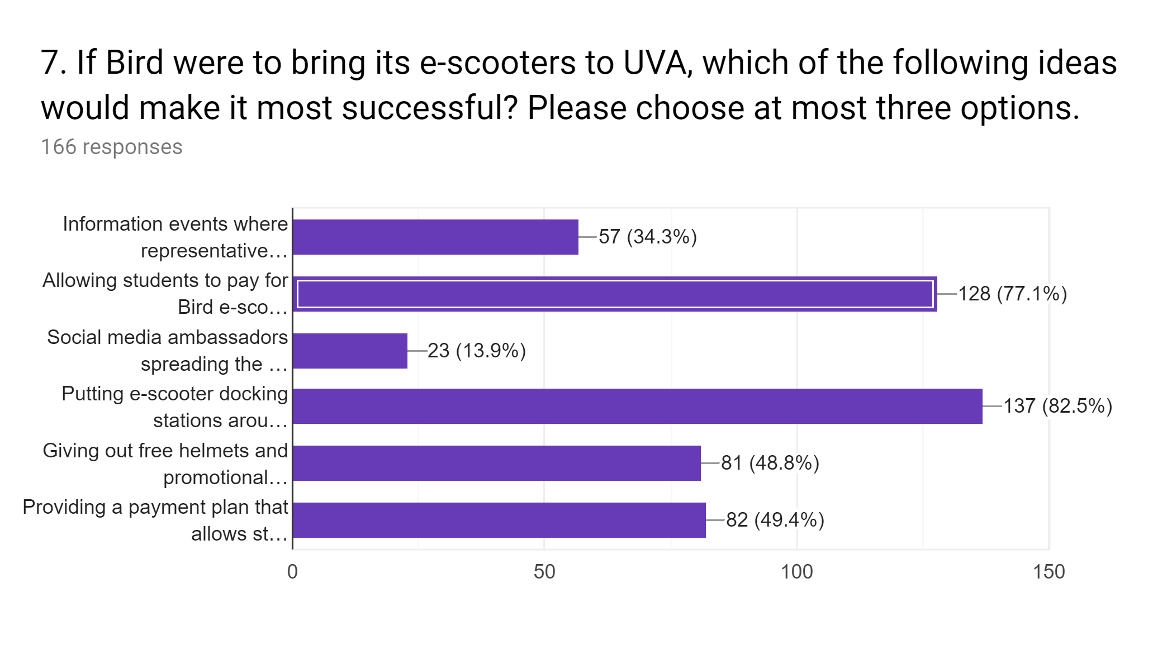
Students prefer location, payment options
Data slide; charts from survey
What questions would apply here
Information Sessions
Paying with Plus Dollars
Social Media Outreach
Prioritize Dock Location
Free Promotional Items
Payment Plan
Notes:
Lastly, with our survey we also wanted to look at consumer preferences. The top two things that students cared about were convenience in paying with plus dollars/cav advantage, and better accessibility in docking locations. With that being said, we can now move on to our recommendations...
POINT HERE - consumer preferences essentially...
Meg’s survey data!

Slide 22
Recommendations and Risks
Notes:
With that being said, let’s move on to our recommendations and risks.

Slide 23
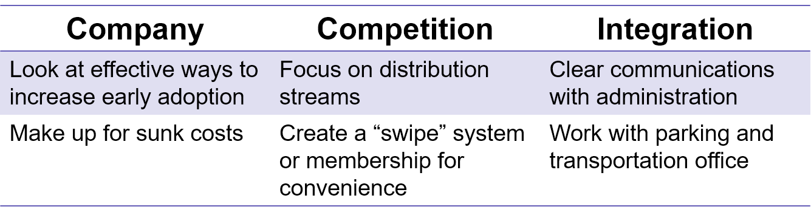


Recommendation
Quick Adoption & Successful Pilot Program
Promotions: Get people onboard quickly, information sessions, brand ambassadors
User Experience: More “Bird Nests” for better accessibility on & off grounds, swipe/membership system
Geofencing: Method of keeping track of scooters and location legality
Notes:
Like we’ve mentioned before, we want to succeed where UBike failed. This starts with looking at effective ways to increase early adoption to make up for initial sunk costs - so our focus here is promotions. We want to have many different methods of promotion to reach a wide variety in audience, so for example informal onboarding sessions and brand ambassadors that give out free stuff and promote Bird to their peers.
Next, from competition, we want to focus on improving the User Experience - as mentioned on the last slide, students care most about convenient ways to buy rides and better accessibility. UBikes for example were mostly on grounds, where students are only 5 minutes or so away from their classes…
Last, to ensure successful integration with the UVA system, we want to make sure that we don’t run into issues that previous campuses experienced with legal issues. To resolve this we want to focus on Geofencing, which keeps track of scooter locations and making sure that they are following administration rules.
What this all leads to is our overall goal of quick adoption and ensuring the success of our pilot program.

Slide 24
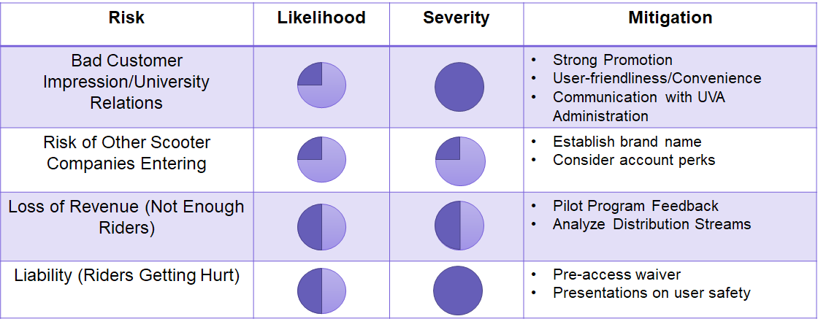
Risks
Notes:
Last but not least, let’s look at the risks we will consider.
First, we want to consider customer impression and university relations. With good promotion methods this won’t be too likely, but the impact is very severe since if we don’t do a good job with customers and administration, we won’t exist on grounds. We can resolve this with good promotion for user friendliness and convenience, as well as making sure UVA administration is secure in our product.
Next up is risk of other companies - Bird has already filed their application to the city of Charlottesville, and when we enter the market, based on the two way table we looked at earlier we can really gain a good brand name recognition for quality and affordability.
Loss of revenue is something we always have to consider, and in this case we want to utilize pilot program feedback to analyze our flaws, and also expand from where UBikes failed in terms of more convenient distribution streams.
The last, but perhaps one of the most important, thing we want to consider is liability of riders. We plan to have waivers to sign and presentations on user safety before a user is allowed to access a scooter, but ultimately if a rider gets hurt then this is a pretty severe issue and the negative impact rider injury could cause would be very severe. Pushing for user safety regarding riding scooters will really help to mitigate this risk.

Slide 25
Q&A
Notes:
Thank you for your time! Does anyone have questions for us?

Slide 26
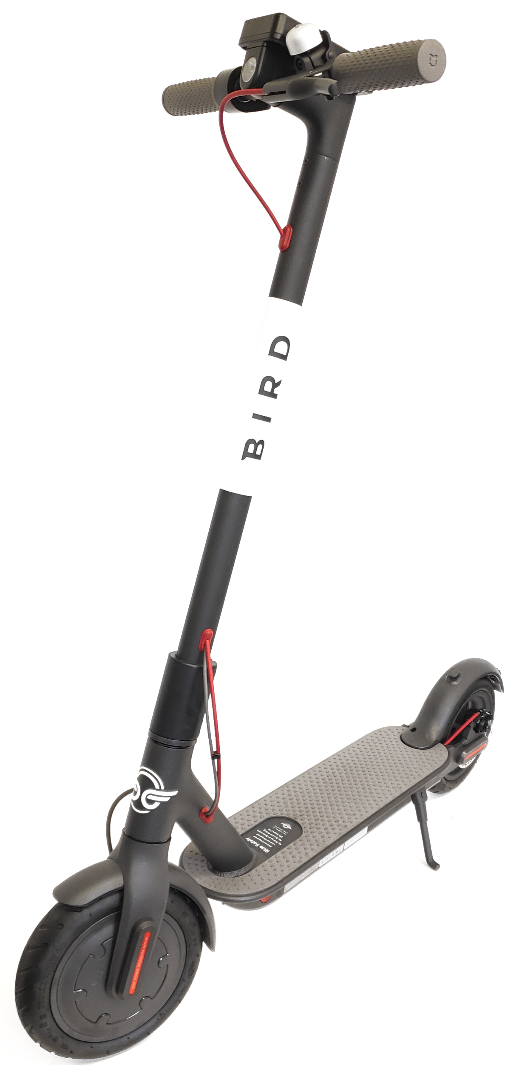
Appendix
Exhibit 1: Public perception of e-scooters by city
Exhibit 2: Public perception of e-scooters by income
Exhibit 3: Short trips rule the roads - Share of vehicle trips by distance, 2017
Exhibit 4: Financial assumptions
Exhibit 5: Uber/Lyft Case Study - Promotions Work
Exhibit 6: How many times per week do you use UVA’s transportation options?
Exhibit 7: Which of the following transportation options do you use the most often to get around UVA?
Exhibit 8: How satisfied are you with UVA’s current transportation options?
Exhibit 9: Bird needs a unique strategy to stand out

Slide 27
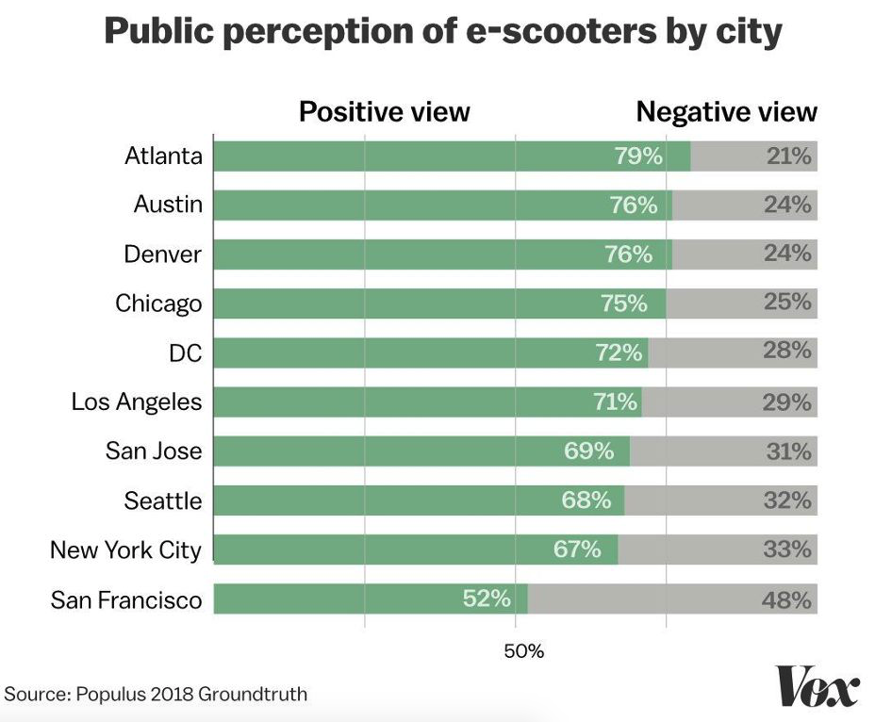
Notes:
Public perception of e-scooters by city

Slide 28
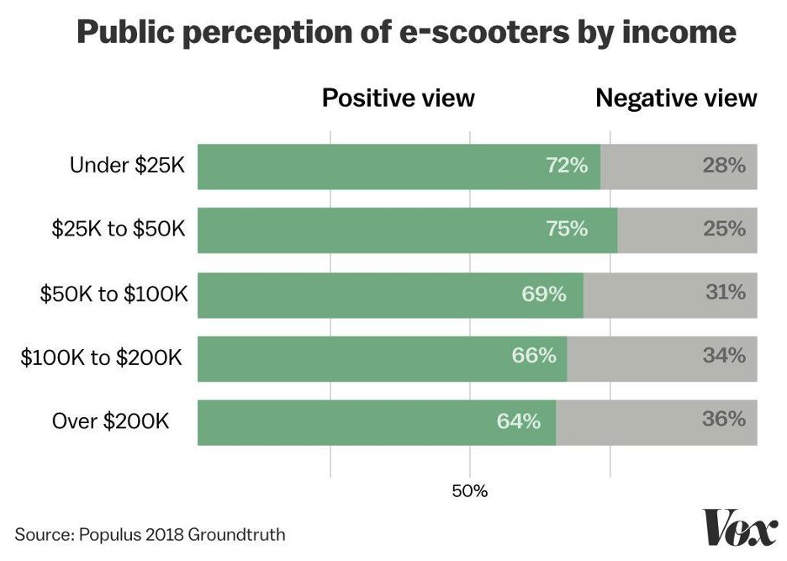
Notes:
Public perception of e-scooters by income

Slide 29
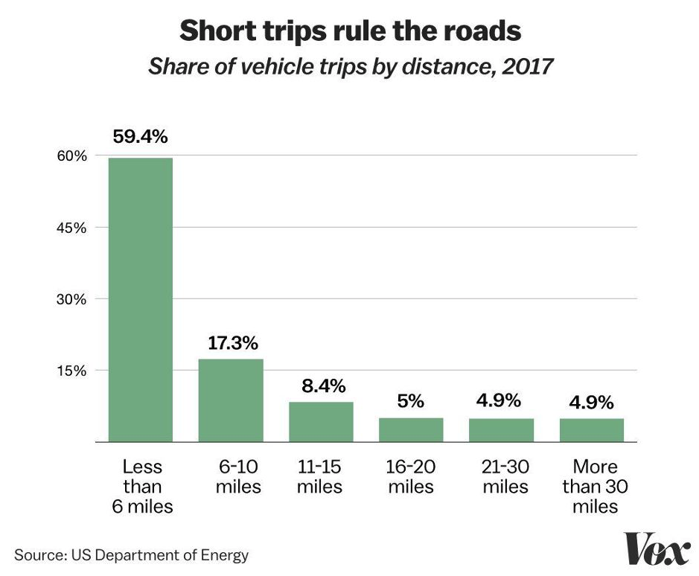
Notes:
Short trips rule the roads - Share of vehicle trips by distance, 2017

Slide 30
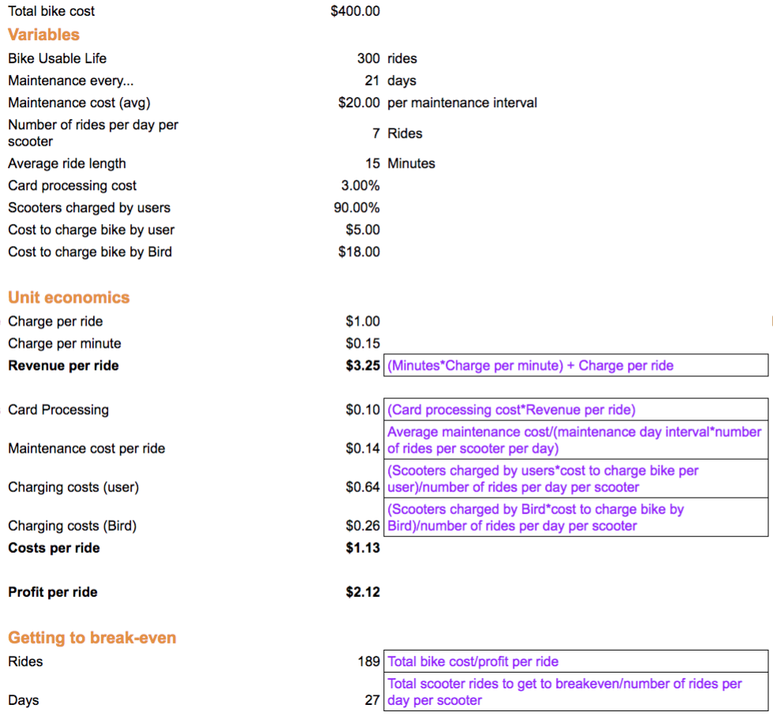
Financial assumptions for Bird entry to UVA
Make assumptions
2. Calculations

Slide 31
Uber/Lyft Case Study: Promotions Work
09/2013: BU and UCLA Growth Strategy
Today: Uber/Lyft Have Exploded
Boston University Uber partnership
Provided special promo codes that got new riders free or discounted rides
Distributed coupons on Chegg that advertised free Uber ride codes
UCLA Lyft partnership
Partnered with Greek organizations and student groups to market themselves as a safe and reliable mode of transport, as well as provide free rides for specific, off-campus events
Since 2013, Uber trips to neighborhoods in Boston have increased by over 250%
Lyft spent $96.1 million on marketing in the first half of 2015, more than twice its net revenue in the same period
Los Angeles passengers saved more than 11.2 million travel hours in 2017 because of Lyft — time that is valued at $428 million
Source: https://www.usatoday.com/story/news/nation/2013/09/11/lyft-uber-for-university-students/2800477/,
http://business.time.com/2013/06/27/rideshare-battle-shifts-to-l-a-city-tells-uber-lyft-sidecar-to-stop-picking-up-riders/,
https://www.boston.com/news/technology/2015/10/27/the-rise-of-uber-in-boston-by-the-numbers,
https://www.latimes.com/business/technology/la-fi-0105-lyft-growth-20160105-story.html
https://www.bizjournals.com/losangeles/news/2018/01/16/lyft-drove-221-million-into-los-angeles-economy.html

Slide 32
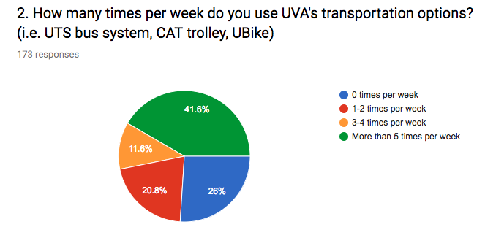

Slide 33
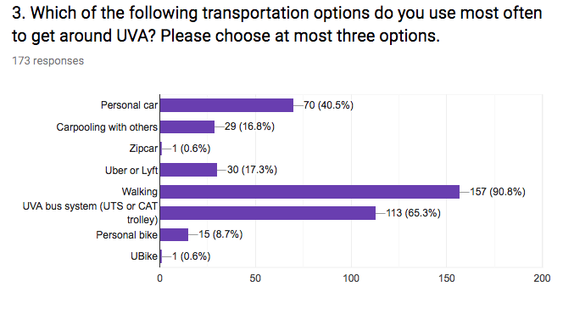

Slide 34
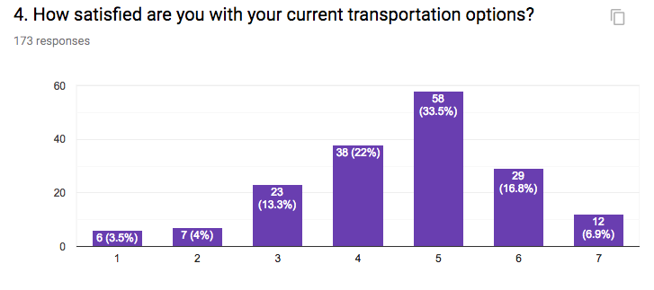

Slide 35


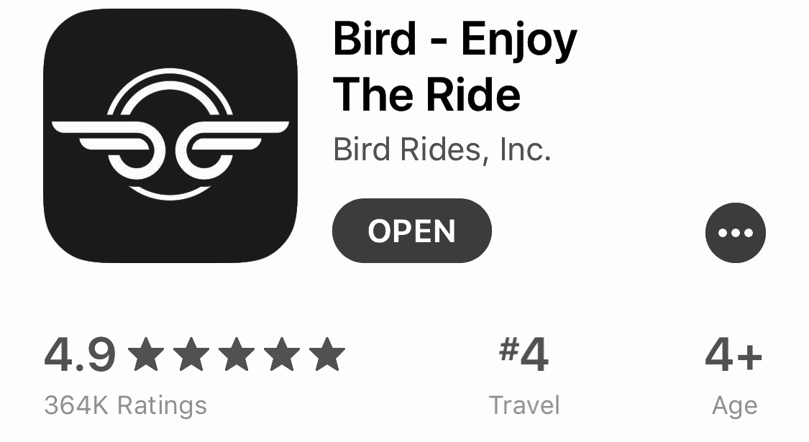
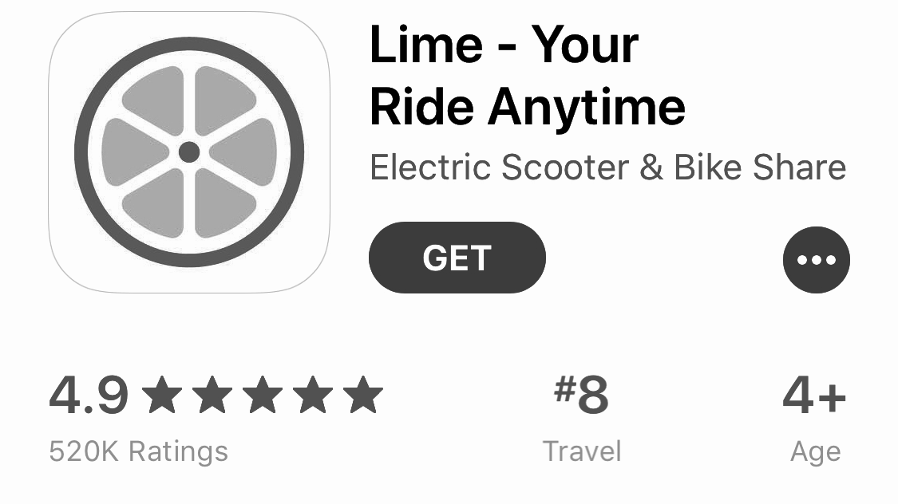
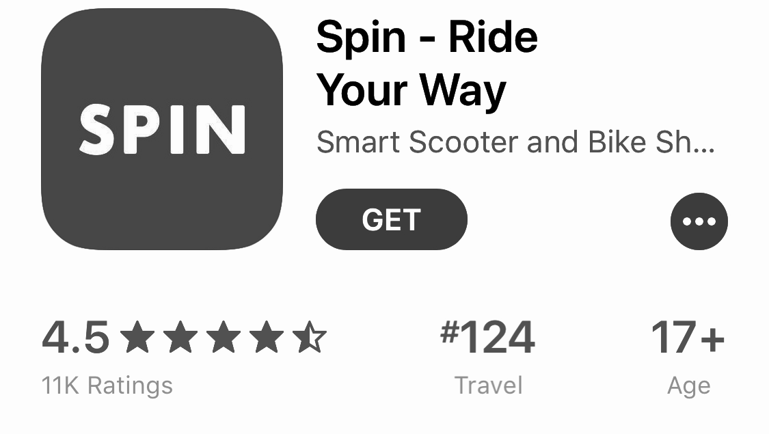
Bird needs a unique strategy to stand out
73 cities 17 campuses | 101 cities 35 campuses | 9 cities 5 campuses
Bird needs to differentiate itself to stand out to
1) university administration, and 2) students.
Notes:
In a constantly tight battle for market share within the e-scooter business, Bird and its competitors are forced to keep their prices low and have little room to differentiate in terms of pricing. What Bird needs to do in order to establish itself and make a profit within the UVA area is to gain recognition with university staff and students. Bird needs to separate itself from its competition, which Keyu and Meg will discuss in detail now.
Perks: Bird $5 vs Lime $3 for referral
Differentiator: University Coverage
Customer Services: 363K 4.9 points on App Store, vs Lime 417k 4.9 points on app store vs 11 rating

